Slide 1
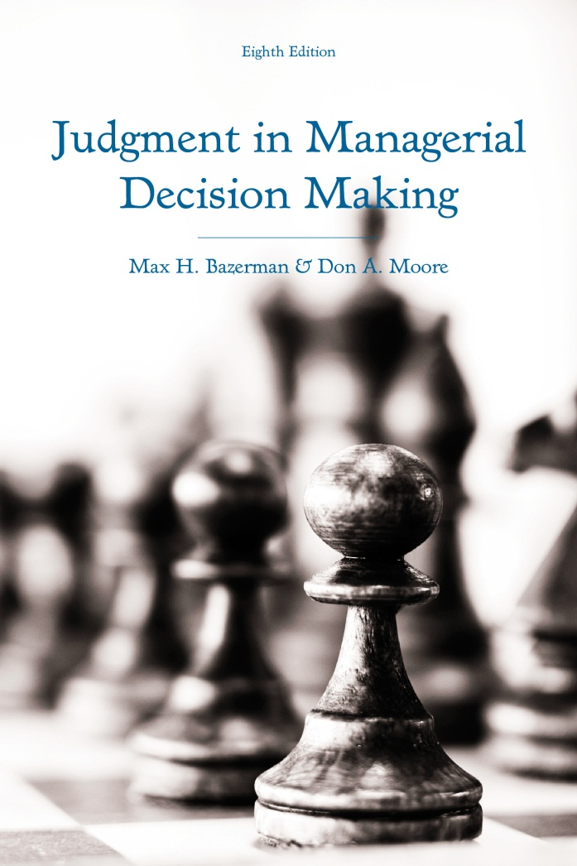
Judgment in Managerial Decision Making 8e
Chapter 4
Bounded Awareness
Copyright 2013 John Wiley & Sons

Slide 2
Problem 1: Role-Playing Exercise
Six people are randomly assigned to the roles A, B, C, D, E, and F. A is randomly selected and given $60 to allot among A, B, C, D, E, and F. The amounts given to B, C, D, E, and F must be equal, but this amount may be different from the amount that A allocates to A (herself/himself). B, C, D, E, and F will be asked to specify the minimum amount that they would accept. If the amount offered by A to each of B, C, D, E, and F is equal to or greater than the largest amount speciﬁed by B, C, D, E, or F, the $60 will be divided as speciﬁed by A. If, however, any of the amounts speciﬁed by B, C, D, E, and F are larger than the amount offered by A, all six parties will receive $0.
Notes:
Take a moment to read the following game.
Pretend that you were in the role of Player A. How much money would you allocate to the other players in order to maximize your payoff?

Slide 3
Problem 2: Pick a Winner
You are given a choice of boxes X, Y, or Z. One of these three boxes has a valuable prize in it. The other two boxes are empty. After you pick one of the boxes, the computer will open one of the other two boxes, show you that this unchosen box does not have the prize, and offer you to trade your chosen box for the unopened, unchosen box. For example, if you were to choose box X, the computer would open one of the two other boxes (e.g., Y) and show you that it is empty. The computer would then offer you the opportunity to switch your choice from X to Z.
A student who participated in the study picked box Y. The computer then opened box Z, showed the student it was empty, and offered the student to trade box Y (which the student originally chose) for box X (the remaining unopened, unchosen box).
Notes:
Now, consider this game where you are attempting to pick a prize.
If you were the student in this problem, would you trade box Y for box X?

Slide 4
Problem 3: Acquiring a Company
You are Company A
You want to acquire Company T
  Company T is undertaking a project
  Project outcome range: $0 to $100
  All outcomes equally likely
  Company T worth 50% more if acquired
Offer must be made early
Company T will decide after outcome is known
Notes:
Now, consider this problem.
Suppose you represent Company A and you are considering whether you should acquire Company T.
Company T is currently undertaking an oil exploration project and the outcome of this project will dictate the value of Company T.
Any outcome in terms of Company T’s share prices from $0 to $100 are equally likely.
If Company T is acquired, it will be worth 50% more under Company A.
However, you must make an offer before the outcome of Company T’s exploration project is known.
Furthermore, Company T will wait to accept or reject your offer until the outcome of the project is known.
Company T will accept any offer you make that is greater than or equal to its actual value after the project.
Given this information, how much would you offer Company T for each share?

Slide 5
Problem 4: Role Playing Exercise
Six people are randomly assigned to the roles A, B, C, D, E, and F. A will be randomly selected and given $60 to allot among A, B, C, D, E, and F. The amounts given to B, C, D, E, and F must be equal, but this amount may be different from the amount that A allocates to A (herself/himself). B, C, D, E, and F will be asked to specify the minimum amount that they would accept. If the amount offered by A to each of B, C, D, E, and F is equal to or greater than the smallest amount speciﬁed by B, C, D, E, or F, the $60 will be divided as speciﬁed by A. If, however, all of the amounts speciﬁed by B, C, D, E, and F are larger than the amount offered by A, all six parties will receive $0.
Notes:
Now, consider this version of the role-playing exercise that was presented in Problem 1.
How much would you allocate to each player?

Slide 6
Problem 5: Pick a Winner
You are given a choice of boxes X, Y, or Z. One of these three boxes has a valuable prize in it. The other two boxes are empty. After you pick one of the boxes, the computer may open one of the other two boxes, show you that this uncho­sen box does not have the prize, and offer you to trade your chosen box for the unopened unchosen box. The computer will make its decision whether to open a box and offer you a switch with the goal of minimizing the likelihood that you get the prize. For example, if you were to choose box X, the computer might decide to open one of the two other boxes (e.g. Y), show you it’s empty, and offer you the opportunity to switch your choice from X to Z.
A student who participated in the study picked box Y. The computer then opened box Z, showed the student it was empty, and offered the student to trade box Y (which the student originally chose) for box X (the remaining unopened, unchosen box).
Notes:
Review this version of the exercise that you were presented in Problem 2.
If you were the student depicted here, would you trade box Y for box X in order to maximize your chances of winning?

Slide 7
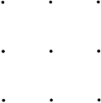
Problem 6: Connect the Dots
Without lifting your pencil (or pen) from a piece of paper, draw four (and only four) straight lines that connect all nine dots shown here:
Notes:
Raw nine dots arranged like the picture below on a piece of paper.
Then try to connect all nine dots by drawing four straight lines without lifting your pencil or pen from the paper.

Slide 8
Ponzi scheme cracks in 2008—Bernie Madoff
Why did nobody notice earlier?
Bounded awareness
Notes:
Now that you have attempted to solve these problems, keep them in mind and we will return to your solutions later.
In general, we have a tendency to ignore important information. Consider Bernie Madoff’s elaborate Ponzi Scheme that cracked in 2008.
Over the course of 3 decades, Bernie Madoff developed an elaborate Ponzi Scheme that allowed him to steal from investors while making a handsome profit and making it appear as if his funds were earning abnormally high returns.
However, there were several warning signs that people should have noticed before Madoff’s scheme cracked.
Many of the managers of Madoff’s feeder funds saw some hints that there was something wrong, but they didn’t have the motivation to investigate any further.
Investors, government officials, and investment bankers also failed to notice that something was wrong.
The CEO of Access International Advisers and Marketers also continued to invest in Madoff and to refer his clients to Madoff despite repeated warnings from outsiders and evidence that Madoff’s returns were not possible to achieve.
Just like the people who failed to notice the warning signs or to take action against Madoff, we often fail to notice important details.
Much like we use heuristics to simplify the problem-solving process, we selectively filter out some of the information available to us in order to prevent ourselves from being overwhelmed with every tiny detail that we encounter.
This tendency to fail to notice important details is referred to as bounded awareness.

Slide 9
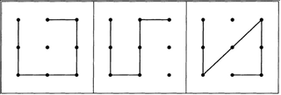
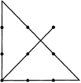
Problem 4: Connect the Dots
What Most People Do
The Correct Solution
Notes:
To provide you with another example of bounded awareness, consider the connect-the-dots problem that you attempted to solve.
The majority of people attempt to solve the problem in a similar fashion to the three pictures to the left.
As you can see, people tend to impose boundaries on themselves when attempting to solve the problem.
However, if they read more carefully, they would be able to see that the problem does not specify that they must keep their pencil within the boundary imposed by the dots.
As a result, they stifle their creativity and are prevented from arriving at a more creative solution like the one to the right.

Slide 10
Forms of Bounded Awareness
Inattentional blindness to obvious information.
The failure to notice obvious changes in one’s environment.
The tendency to focus on only a part of the problem at hand.
Bounded awareness in groups.
Bounded awareness in strategic decisions.
Bounded awareness in auctions.
Notes:
There are six forms of bounded awareness that we will cover in today’s discussion:
Inattentional blindness to obvious information.
-The failure to notice obvious changes in one’s environment.
-The tendency to focus on only a part of the problem at hand.
-Bounded awareness in groups.
-Bounded awareness in strategic decisions.
-Bounded awareness in auctions.

Slide 11
Inattentional Blindness
http://www.youtube.com/watch?v=Ahg6qcgoay4
Did you notice anything unusual in the video?
Other examples of inattentional blindness.
Notes:
Now, let’s discuss inattentional blindness.
Try watching the following video and watch carefully for the number of times that the players on the court pass the basketball.
Did you notice anything unusual?
If not, try watching the video again but look for anything unusual.
You should have noticed by now that a person in a gorilla costume walked through the middle of the players passing the basketball.
However, you probably didn’t notice the first time that you watched the video because you were so focused on counting the number of times that the basketball was being passed.
The general tendency to not notice what you aren’t looking for, even when you are looking directly at it, is called change blindness.
Other examples of situations where inattentional blindness may be an issue:
An airplane pilot failing to notice another plane on the runway as he is focused on his controls.
A driver on their cellphone failing to notice another car in front of them.
Completely not noticing something that your spouse told you while you were paying attention to something else.

Slide 12
Change Blindness
http://www.youtube.com/watch?v=vBPG_OBgTWg
Change blindness
Other examples of change blindness:
  Auditors of companies
  Unethical behavior
Notes:
Much like in the case of inattentional blindness, we often fail to notice very obvious visual stimuli.
However, in the case of change blindness, we often fail to notice very obvious changes in our environment, such as people changing.
We often implicitly know that something strange is going on, but we fail to consciously notice environmental changes.
The more subtle the change, the less likely we are to notice it.
However, change blindness does not only occur for visual stimuli, but for a variety of important behaviors.
For example, the auditor of a company may approve some statements that stretch the boundaries of ethical standards one year.
The next year, the auditor may approve statements that are clearly unethical and possibly illegal.
However, if the company changed from being completely ethical to performing blatantly illegal reporting practices the next year, the auditor may have been more likely to notice the change in reporting standards and to report the company for its illegal practices.
Much like the accountant, we too are prone to a slippery slope of ethical behavior where we fail to notice that our behavior has become unethical over time because a series of decisions where we slightly bend an extra rule or two may accumulate to a point where we are blatantly breaking all of the rules, but we fail to notice that we are doing so.

Slide 13
Focalism and the Focusing Illusion
Focalism
Overestimation of our emotional reactions
  Affective forecasting errors
  Overweighting salient information
Focusing on specific events
Notes:
Focalism is the tendency to focus too much on a single event and to ignore other events that may be happening concurrently.
Often, this may lead to us overestimating our own emotional reactions.
For example, we often make what are known as affective forecasting errors where we overestimate the duration of our current emotional state. In fact, research has actually demonstrated that although most people think that they would enjoy television more without commercial breaks, they actually enjoy it more with commercial breaks because they overestimate how long their positive experience of watching a television show will last. Essentially, the enjoyment that people get from watching television shows declines over the course of the shows and commercial breaks allow them to experience a reinvigorated enthusiasm for the show when it returns from a commercial break.
We also overweight the impact of focal information on our emotional state or our happiness. For example, Southern Californians and Midwesterners both believe that Californians are happier than Midwesterners, but when they are actually asked to indicate their subjective level of happiness individually, Southern Californians and Midwesterners are equally happy. Presumably, this is because people tend to think of the salient difference in the quality of weather between the two states while ignoring other considerations such as the cost of living or the traffic.
We also tend to overestimate the probability of focal events occurring. This tendency becomes particularly prevalent as we consider more events.
For example, even though people estimating the probability of various basketball teams winning the NBA Finals, their probability estimates should all add to 100. However, this is often not the case and as people consider a larger subset of teams, these errors increase.
In one study, people estimated the probability of the 1995 NBA champion coming from either a specific conference, division, or team.
When asked to estimate the probability of the NBA champion coming from each of two conferences, he average set of estimates totaled to 102%.
When asked to estimate the probability of the NBA chapion coming from each of four divisions, the average set of estimates totaled to 141%.
When asked to estimate the probability of the NBA champion being each of eight remaining teams in the playoffs, the average set of estimates totaled 218%.
Doctors also make similar mistakes, as one study asking them to estimate the probability that a patient had each of four possible diagnoses, the sum of their estimates totaled to more than 100%.
Clearly, as more different events are considered, people became more likely to overestimate the probability of a focal event occurring.
Sadly, the tendency to focus on focal events has resulted in tradjedy.
In the case of the 1986 crash of the Challenger spacecraft, engineers falsely concluded that there was no relationship between the launching temperature of a shuttle and the probability of O-ring failure.
However, they made this decision by only looking at the lack of a clear relationship on 7 launches where O-ring failure had occurred.
Had they looked at the entire set of 24 test launches that included successful launches with no O-ring failure, they would have likely concluded that O-ring failure was not only associated with low launching temperatures, but was a near certainty given the planned launch temperature of the shuttle that eventually exploded upon takeoff.

Slide 14
Bounded Awareness in Groups
Much decision-making occurs in groups.
Mentioned information is considered.
Groups focus on shared information.
Groups should emphasize unique information.
Notes:
Group decision-making is a key aspect of organizations.
Groups tend to consider information that is explicitly mentioned and shared by individuals.
As a result, groups should allow people to pool information together to gather all of the relevant information about a problem before arriving at an optimal solution.
However, people often fail to share the information that they uniquely hold and information that all group members share tends to be discussed.
This results in groups making decisions that drastically differ from the decisions that individuals with full information would make.
When information is split among the individuals within a group, groups make very different decisions than groups where all members have the same information about a problem.
In order to capitalize on the full potential of groups to allow individual members to pool unique information so that the group can gather all of the relevant information to solving a problem, groups should emphasize the value of unique information and identify experts on particular topics who are responsible for sharing information that they are the most likely to uniquely hold about a problem.

Slide 15
Bounded Awareness in Strategic Settings
Bounded awareness of rules
Bounded awareness of others’ decisions
Notes:
Two ways that we often suffer from bounded awareness in strategic settings:
Our knowledge of subtle changes in the rules to games.
Our consideration of the decision making process of others.
To illustrate these issues, we will revisit some of the problems that you attempted to solve earlier.

Slide 16
Multiparty Ultimatum Games
Consider Problems 1 and 4
  Problem 1: Largest acceptance price
  Problem 4: Smallest acceptance price
Problem 1
  Will all players ask for less than $10?
  Maximizing strategy: 10-10-10-10-10-10
Problem 2
  Will at least one player ask for $1?
  Maximizing strategy: 55-1-1-1-1-1
Notes:
Let’s consider problems 1 and 4, which are both Multiparty Ultimatum games. Though the problems appear very similar on the surface, they have a crucial difference in rules:
In Problem 1, the greatest minimum acceptance price of the other players is used to determine whether Player 1’s allocation is paid out or whether $0 is paid out.
However, in Problem 2, the smallest minimum acceptance price of the other players is used to determine whether Player 1’s allocation is paid out or whether $0 is paid out.
In this game, there tend to be two dominant preferences amongst players: complete fairness ($10 to everybody) or at least getting something ($1 is better than nothing).
This information could be used to estimate the optimal allocation for the game, but players often overestimate probabilities.
In Problem 1, the key question is whether every player will ask for less than $10, as it is probably unlikely that they will all ask for $1.
Because people overestimate the probability of joint events occurring, they often overestimate the probability that all players will ask for less than $10.
This often results in them making too low of offers and earning $0.
In Problem 2, the key question is whether at least one player will ask for $1.
However, because people underestimate the probability of at least one player accepting $1, they often offer too much.
This results in them giving up too much in the context in the game.
Clearly, a minor change in the rules of this game drastically changes the profit-maximizing offers that Player 1 should make.

Slide 17
What Do People Actually Do?
Notes:
Here are some actual results from research using the Multiparty Ultimatum game.
As you can see, despite the two problems containing a key difference in details, participants offered about the same amount across both studies.
This means that in Problem 1, many made low ball offers and made nothing while in Problem 4, many missed an opportunity to capitalize on a key opportunity to make a lot of money.

Slide 18
The Monty Hall Game
Consider Problems 2 and 5
  Problem 2: Box without prize opens
  Problem 5: Box without prize opens if it minizes chance of winning
Problem 2
  Unopened box: 2/3 chance of winning
  People should always switch
Problem 5
  Opened box: 100% chance of winning
  People should never switch
Notes:
Let’s consider Problems 2 and 5. These are different versions of what is known as the Monty Hall problem, which is named after the host of Let’s Make a Deal and two potential dominant strategies that he could have used in deciding whether to reveal a door with no prize or not to reveal any door in the classic game show that parallels this computer game.
Once again, we have two problems with very subtle differences between them.
In Problem 1, a box without a prize always opens.
In Problem 5, a box without a prize only opens if it minimizes the chances of the player winning a prize.
In Problem 2, we know that a box will always be revealed with no prize. This provides useful information:
It provides no information about the probability of the chosen box containing the prize because its probability remains at 1/3 since we already know at the outset that a box with no prize will be opened.
However, it provides us with useful information about the final remaining unopened box.
At the start of the game, all boxes have a 1/3 probability of containing the prize.
However, because we know that probability of the chosen box containing the prize has remained at 1/3, we know that the only remaining box must have a 2/3 probability of containing the prize.
Thus, we should always switch boxes in this version of the game.
In Problem 5, we know that a box with no prize will be opened if it maximizes the probability of Player 2 losing the game.
This also provides us with important information.
If a player picks a box with no prize at the start of the game, then the maximizing strategy for the computer is to not open a box and to end the game rate there.
However, if the player picks a box with the prize at the start of the game, then the maximizing strategy for the computer is to reveal a box and allow the player the opportunity to switch out of hopes that the player will switch from a prize-containing box.
Thus, the fact that a box has been opened means that the player has selected a prize-containing box and should always keep it.

Slide 19
What Do People Actually Do?
Notes:
As you can see, many participants fail to make the correct decision in Problem 2. Though people should choose another box, the majority of people keep the same box even though the other box has double the probability of containing the prize.
In problem 5, people seem to be much better at correctly keeping the same door.
However, most people make the same decision in both versions of this game and only 24% of people make the correct choice in both versions.

Slide 20
Problem 3: Acquiring a Company
If Company A offers $50:
  Offer not accepted if T > $50
  In accepted offers, average T value: $25
  Value to Company A: $37.50
  Company A loss: $12.50
A loses on any offer > $0
Company A shouldn’t offer anything
Notes:
Recall problem 3 that you attempted to solve earlier where Company A debates whether to acquire Company T.
If you recall, Company T was in the middle of an exploration project where it could earn anywhere from $0 to $100, with each of those outcomes being equally likely to occur.
Company A also stood to earn 50% above and beyond the value of Company T if it successfully acquired the company.
This all sounds great, as Company A can earn a premium for acquiring Company T.
However, because Company T will know the outcomes of its exploration project after Company A has already made an offer and because it will only accept an offer that is greater than or equal to its value after the project, Company A should be more careful about what it offers.
Consider the following illustration of Company A’s ideal logic if it initially inclined to offer $50 (the mean expected value of Company T):
Company T will not accept any offer below $50.
This means that if Company T accepts the offer, the mean value of Company T is $25.
Company A would stand to earn a premium of 50% on this value, which would mean the acquisition would be worth $37.50 to company A.
However, because Company A paid $50 to acquire Company T, it would stand to lose $12.50 by acquiring.
If you perform this mental exercise for any potential offer, it becomes clear that Company A loses profit for any offer above $0.
This, Company A should not make an offer for Company T.
This problem illustrates exactly why acquisitions often fail: the company being bought typically has much more information about itself than the acquiring company.
Similar to the winner’s curse where sellers have more information than bidders, large companies often overpay for smaller companies.

Slide 21
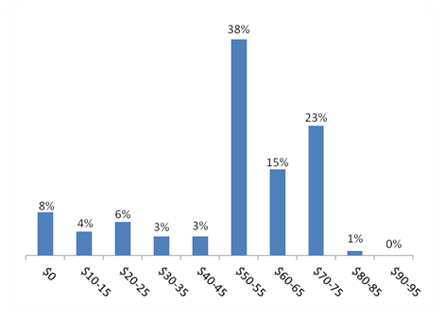
What Do People Actually Do?
Notes:
In the Acquire a Company problem, people routinely fail to see that it is best to not make an offer.
In one study using this exact version of the game, only 8% of people correctly realized that it is best to not make an offer.
Though the logic is quite intuitive, it is difficult to observe that it is best not to make an offer without some help.

Slide 22
More Bounded Awareness
Auctions
Logic versus actual decisions
Reference group neglect
Focus on outcomes
Choice overload in others
Notes:
Bounded awareness also extends beyond the specific problems discussed so far.
As mentioned previously, winners tend to overpay in auctions.
This does not only occur because they lack they have less complete information than sellers, but also because winners often fail to update their own information according to the actions undertaken by those who they are bidding against.
For example, a lack of bidding on a product that a given bidder valued highly should signal to the bidder that he or she may have overvalued the product.
However, the winners of auctions often fail to take this into consideration.
An important implication of many of these problems is that people fail to make decisions that align with logic. Often in competitive group contexts where people must accurately anticipate the actions of many others, we can see final outcomes that drastically vary from what logic would dictate.
We also frequently engage in reference group neglect.
This is the tendency to ignore the abilities of the competition when making strategic decisions.
People tend to enter competitions too frequently when they perform well, ignoring the possibility that others also probably performed well.
People bet too frequently on their home team when the team is good because they often have more information about the home team since it is often their favorite team. Consequently, they neglect information about the competition and lose money on their bets.
We also tend to focus too much on immediately observable outcomes as opposed to factors that can influence many different outcomes.
One example of this is campaign-finance reform.
Though most people are in favor of campaign-finance reform, they typically place it low on their priority list of potential reforms.
As a result, serious advancement towards campaign reform never happens even though it may drastically impact some of the issues that people prioritize such as taxation and education spending cuts.
We also tend to be prone to choice overload, which is the tendency to avoid making decisions when overwhelmed with choice.
Whether looking at the purchase of gourmet jams or bank loans, an abundance of options often results in lower sales.
This is an important consideration for marketers and salespeople, as despite the seeming benefits of choices, too much choice can actually harm sales.
However, people often assume that offering more choice is better.
Overall, bounded awareness is the tendency to fail to notice specific information in a particular domain that may better inform one’s decisions.
By better understanding when one is the most prone to experiencing bounded awareness, he or she can best avoid the pitfalls of bounded awareness.

